Slide 1
Transmission of a voice signal using QPSK modulation technique
Mrinmoy sarkar
PhD student
ECEN-649, Fall 2019
ECE dept., NC A&T State University
Course Instructor:
Jung H. Kim, Ph.D.

Slide 2
Outline
Problem Statement
Specification of the system
Block diagram of the system
Simulation Results
Conclusion and Future work

Slide 3
Problem Statement
A recorded voice signal is needed to be transmitted over a noisy channel and recovered the original voice signal from the noisy received signal using some digital communication techniques such as sampling, compression, quantization, encoding, QPSK modulation & demodulation, decoding, dequantizing, expanding and digital filtering. The error performance of the system and the quality of the received signal needs to be verified.

Slide 4
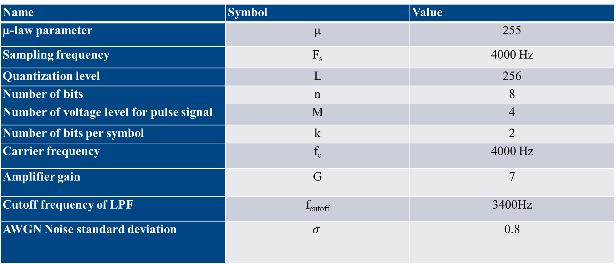
Specification of the system
Name | Symbol | Value
µ-law parameter | µ | 255
Sampling frequency | F_{s} | 4000 Hz
Quantization level | L | 256
Number of bits | n | 8
Number of voltage level for pulse signal | M | 4
Number of bits per symbol | k | 2
Carrier frequency | f_{c} | 4000 Hz
Amplifier gain | G | 7
Cutoff frequency of LPF | f_{cutoff} | 3400Hz
AWGN Noise standard deviation | $$σ$$ | 0.8

Slide 5
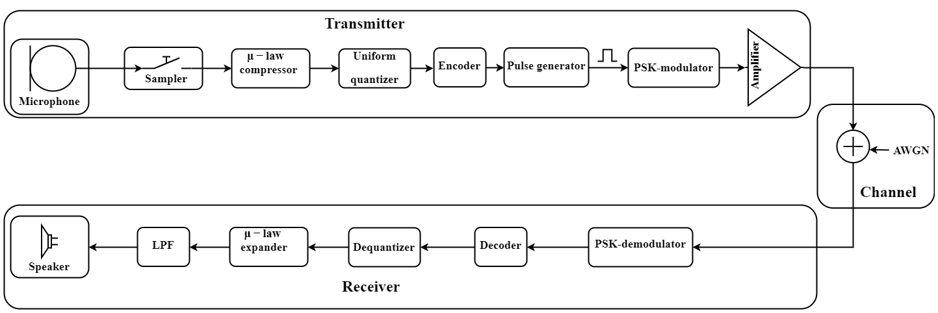
Block diagram of the system
[1,2]

Slide 6
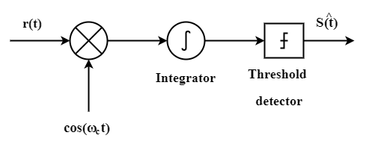







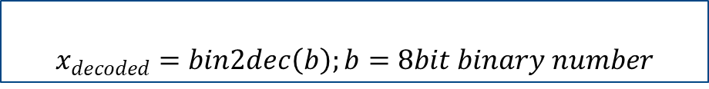

Key Blocks
Sampler:
Channel:
$$X\left(n\right)=X\left(nT_{s}\right); T_{s}=\frac{1}{F_{s}};$$
$$r\left(t\right)=S_{n}\left(t\right)+N(0,σ)$$
PSK demodulator:
Compressor:
$$y=\frac{V∗ln\left(1+\frac{μ\left|x\right|}{V}\right)}{\ln\left(1+μ\right)}sgn(x)$$
Quantizer:
$$Q\left(x\right)=∆∗\left(\frac{x}{∆}+\frac{1}{2}\right)$$
Decoder:
Encoder:
$$x_{decoded}=bin2dec\left(b\right);b=8bit binary number$$
$$n=bin2dec\left(b\right);b=\left\{00,01,10,11\right\}$$
$bin=dec2bin\left(Q\left(x\right),8\right);b=2 bits of bin$
Dequantizer:
Pulse generator:
$$Q\left(x\right)=∆∗x_{decoded}$$
$p\left(t\right)=n for 0<t<T$
Expander:
$$F^{−1}(y)=\frac{sgn(y)}{μ}\left({(1+μ)}^{|y|}−1\right)$$
QPSK modulator:
$S_{n}\left(t\right)=\sqrt{\frac{2E_{s}}{T_{s}}}\cos\left(2πf_{c}t+\left(2n+1\right)\frac{π}{4}\right);n∈\left\{0,1,2,3\right\};$
LPF:
$${y\left(t\right)=F}^{−1}\left(t\right)∗h(t)$$

Slide 7
Simulation Results
G=1

Slide 8

Simulation Results
G=1
[1,2]

Slide 9
Simulation Results
G=1
[1,2]

Slide 10
Simulation Results
G=7

Slide 11
Simulation Results
G=7

Slide 12
Simulation Results

Slide 13
Conclusion and Future work
The transmitted voice signal is correctly received and verified by MATLAB plot and by listening.
The bit error rate is calculated for error analysis.
The bit error rate is reduced to zero with proper tuning of the amplifier gain.
Future work:
The quality of the receive signal can be improved
by using higher sampling rate.
by increasing the quantization levels.
by designing a better low pass filter with higher order.
[1,2]

Slide 14
References
https://en.wikipedia.org/wiki/Phase-shift_keyinghttps://www.mathworks.com/
https://www.sharetechnote.com/html/Handbook_Communication_awgn.html
http://www.sis.pitt.edu/prashk/inf1072/Fall16/modulation.pdf
Lathi, Bhagwandas Pannalal. Modern Digital and Analog Communication Systems 3e Osece. Oxford University Press, Inc., 1998.

Slide 15
Thank You
?

